Slide 1
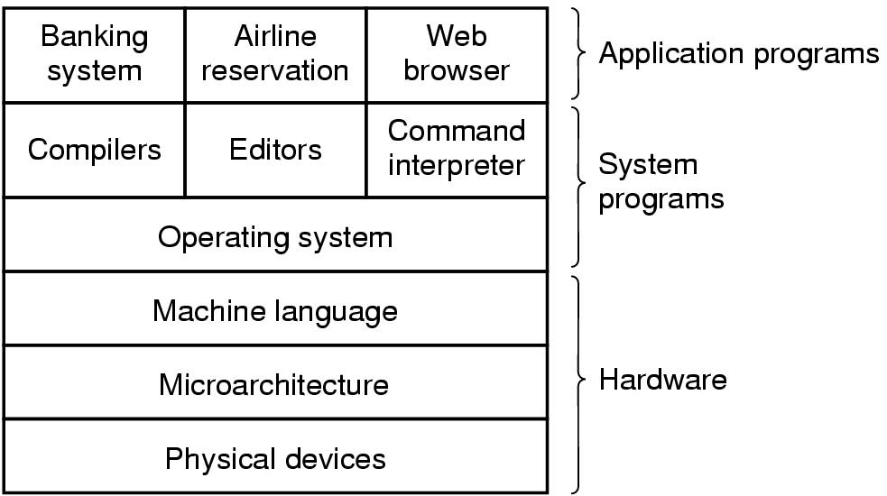
Introduction
A computer system consists of
hardware
system programs
application programs

Slide 2
What is an Operating System
It is an extended machine
Hides the messy details which must be performed
Presents user with a virtual machine, easier to use
It is a resource manager
Each program gets time with the resource
Each program gets space on the resource

Slide 3
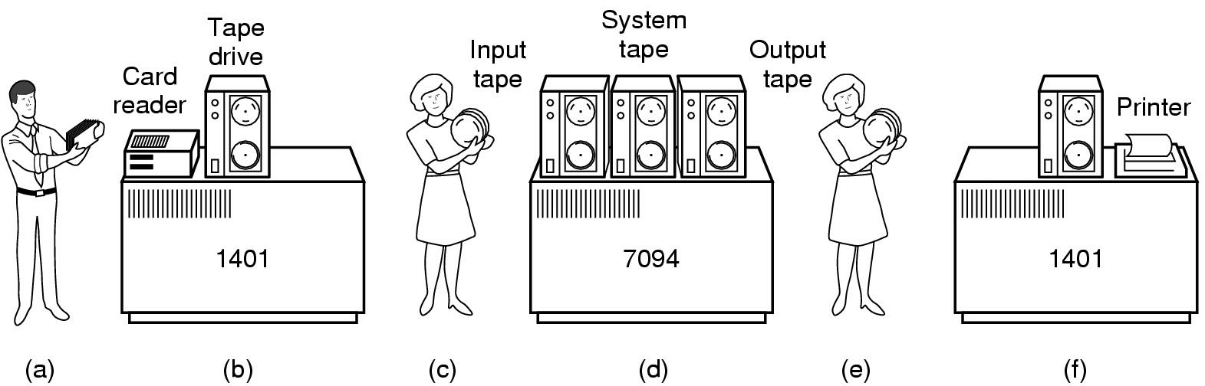
History of Operating Systems (1)
Early batch system
bring cards to 1401
read cards to tape
put tape on 7094 which does computing
put tape on 1401 which prints output

Slide 4
History of Operating Systems (2)
First generation 1945 - 1955
vacuum tubes, plug boards
Second generation 1955 - 1965
transistors, batch systems
Third generation 1965 – 1980
ICs and multiprogramming
Fourth generation 1980 – present
personal computers

Slide 5
The Operating System Zoo
Mainframe operating systems
Server operating systems
Multiprocessor operating systems
Personal computer operating systems
Real-time operating systems
Embedded operating systems
Smart card operating systems

Slide 6
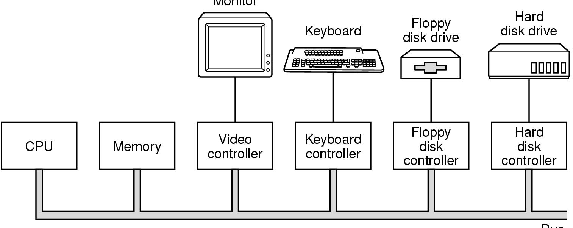
Computer Hardware Review (1)
Monitor
Bus
Components of a simple personal computer

Slide 7
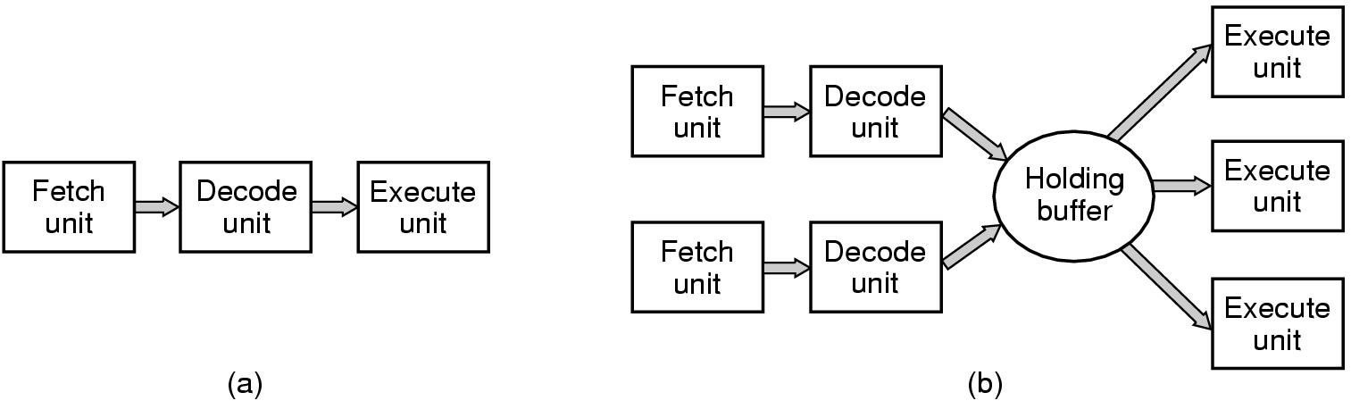
Computer Hardware Review (2)
(a) A three-stage pipeline
(b) A superscalar CPU

Slide 8
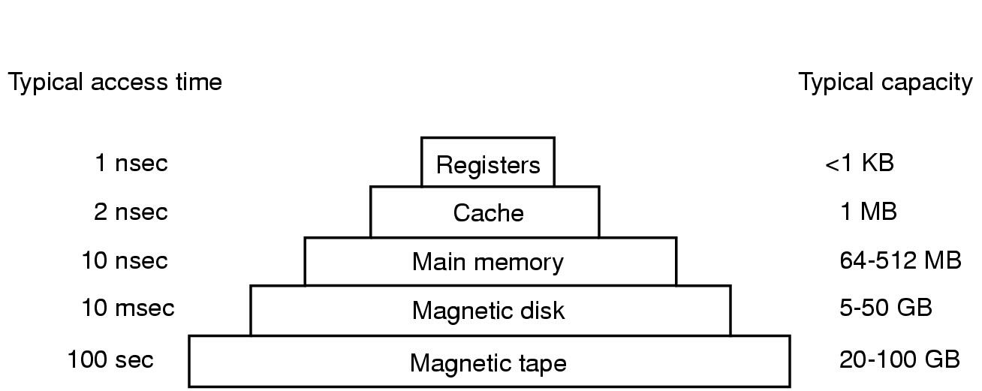
Computer Hardware Review (3)
Typical memory hierarchy
numbers shown are rough approximations

Slide 9
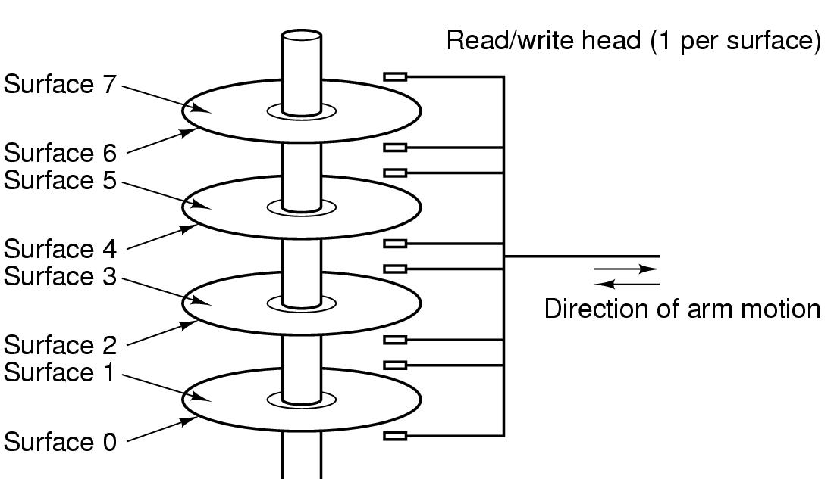
Computer Hardware Review (4)
Structure of a disk drive

Slide 10
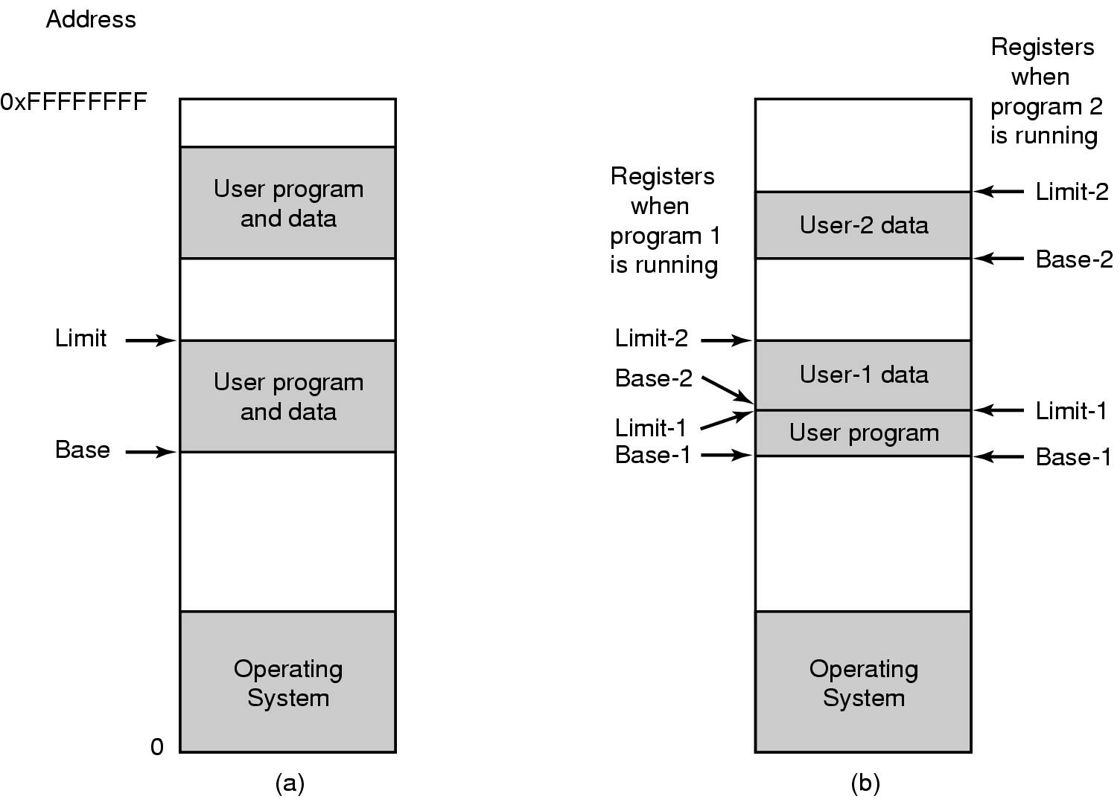
Computer Hardware Review (5)
One base-limit pair and two base-limit pairs

Slide 11
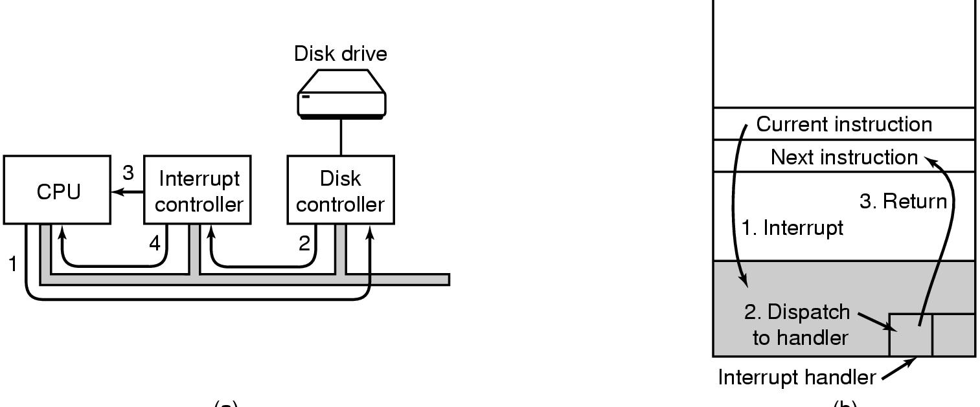
Computer Hardware Review (6)
(a)
(b)
(a) Steps in starting an I/O device and getting interrupt
(b) How the CPU is interrupted

Slide 12
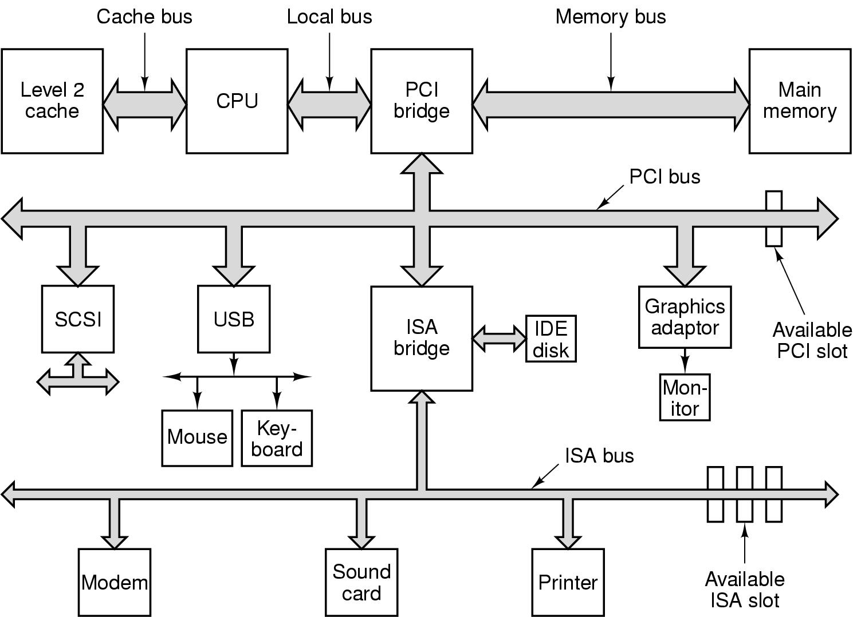
Computer Hardware Review (7)
Structure of a large Pentium system

Slide 13
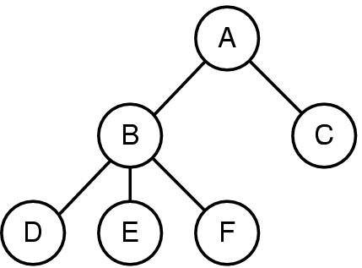
Operating System Concepts (1)
A process tree
A created two child processes, B and C
B created three child processes, D, E, and F

Slide 14
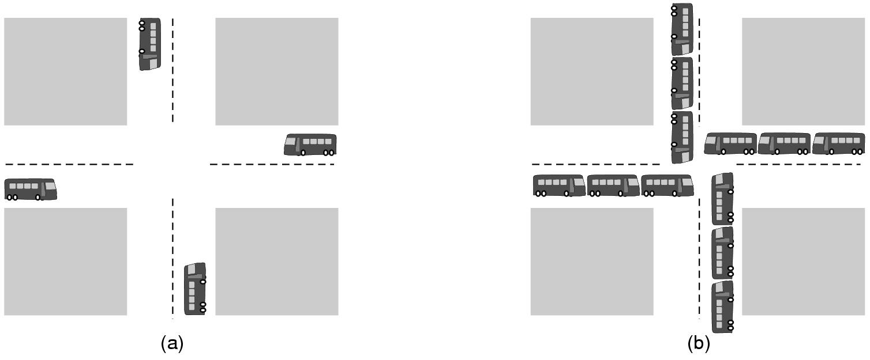
Operating System Concepts (2)
(a) A potential deadlock. (b) an actual deadlock.

